Slide 1
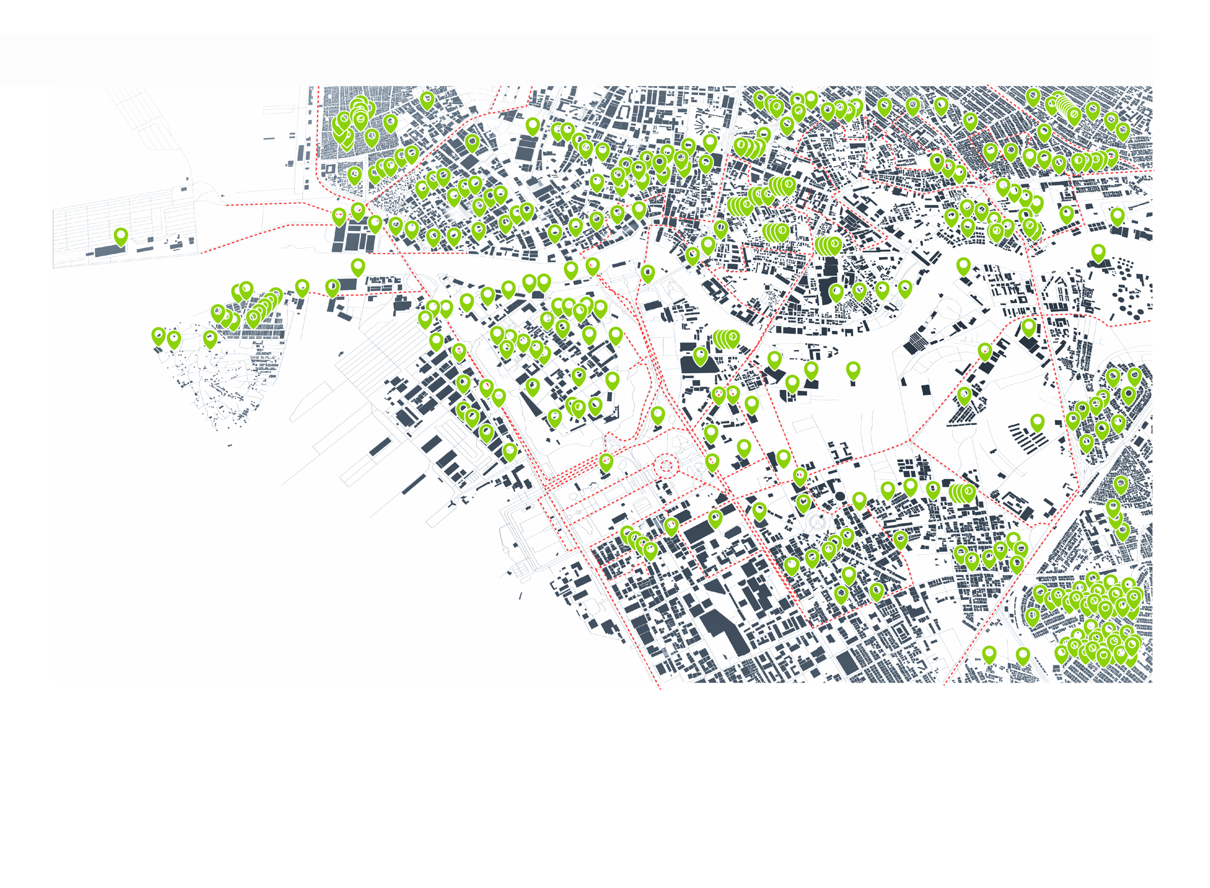
tiramizoo Titel
Datum

Slide 2
Agenda:

Slide 3
MAIN TASKS
TRMZ consulting steps to understanding the relevant requirements
commitment
5
Configuration
SAAS Start
4
Solution proposal
3
TRMZ Product
selection
2
Analysis of customer Requirements & KPIs
1
TRMZ Company presentation
time

Slide 4
MAIN TASKS
TRMZ consulting steps to understanding the relevant requirements
commitment
Individualisation
Specific to product
Custom Expansion
Offer & Start
Configuration
SAAS Start
4
Solution proposal
3
TRMZ Product
selection
2
Analysis of customer Requirements & KPIs
1
TRMZ Company presentation
time

Slide 5
MAIN TASKS
TRMZ consulting steps to understanding the relevant requirements
New product
Joint Dev Offer & Start
commitment
Individualisation
Specific to product
Custom Expansion Offer & Start
Configuration
SAAS Start
4
Solution proposal
3
TRMZ Product
selection
2
Analysis of customer Requirements & KPIs
1
TRMZ Company presentation
time

Slide 6
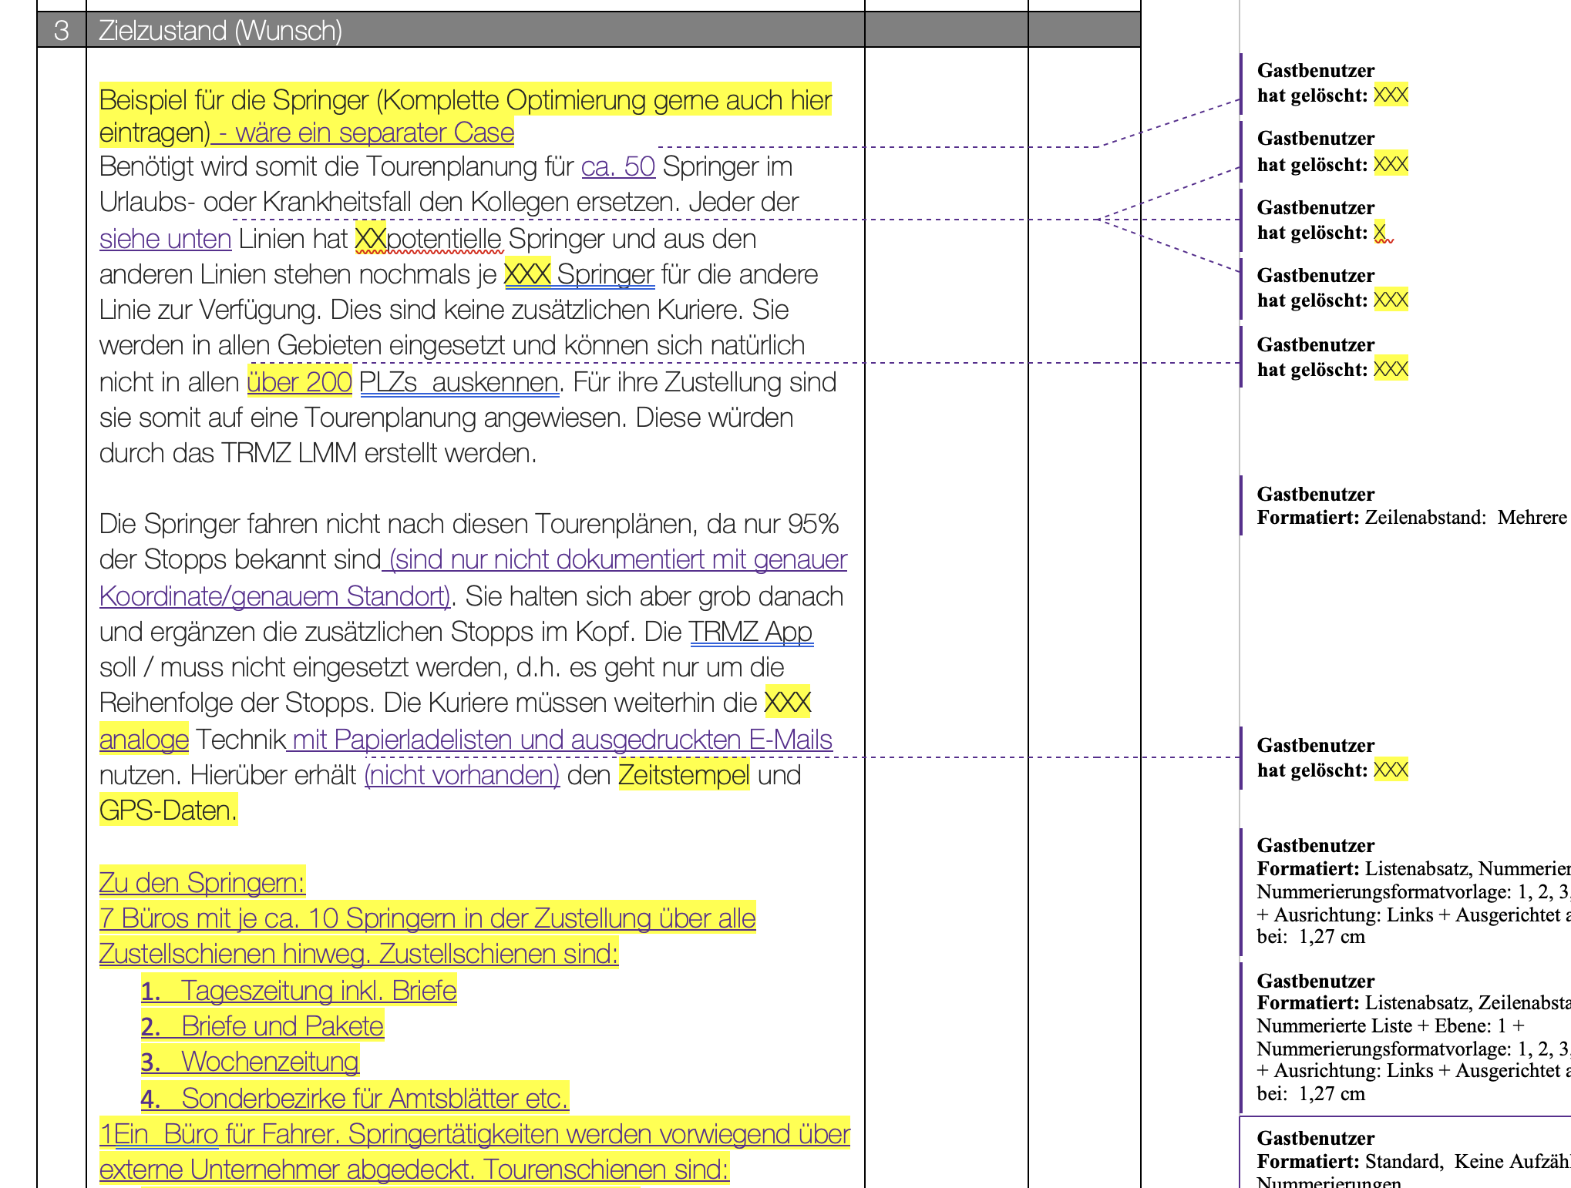
MAIN TASKS
TRMZ consulting steps to understanding the relevant requirements
2
Analysis of customer Requirements & KPIs
The TRMZ Requirements Analysis:
How do you work today?
Why do you want to change (now)?
How do you want to work in the future?
How do you want to measure the success of the future state?
What is your intended saving / revenue increase or budget
Timeline
Single Source of Truth

